Slide 1
Loyalty Prediction

Slide 2
Problem Statement
Create a predictive model for sports team fan loyalty using factors like merchandise sales, attendance, wins, and losses. Enable organizations to enhance engagement and optimize resource allocation.

Slide 3
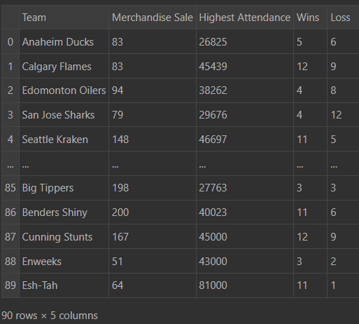
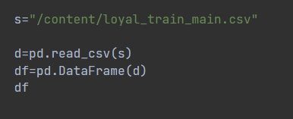
Data input

Slide 4
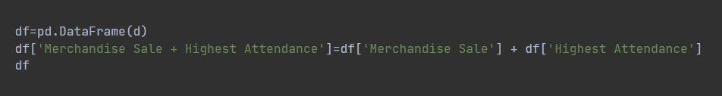
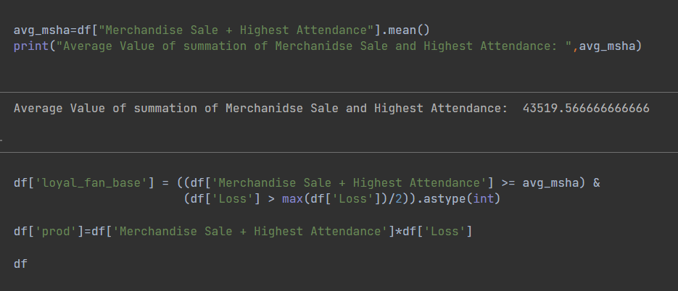
Data preprocessing

Slide 5
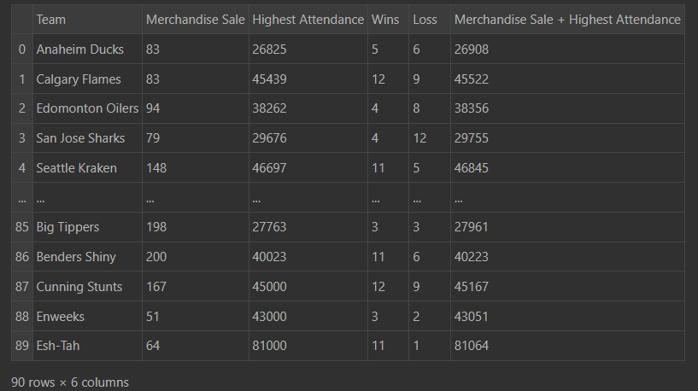
Before

Slide 6
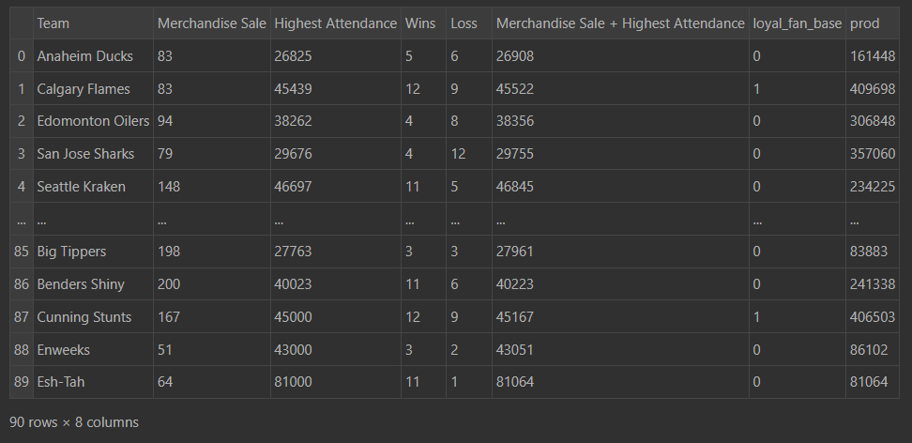
After

Slide 7
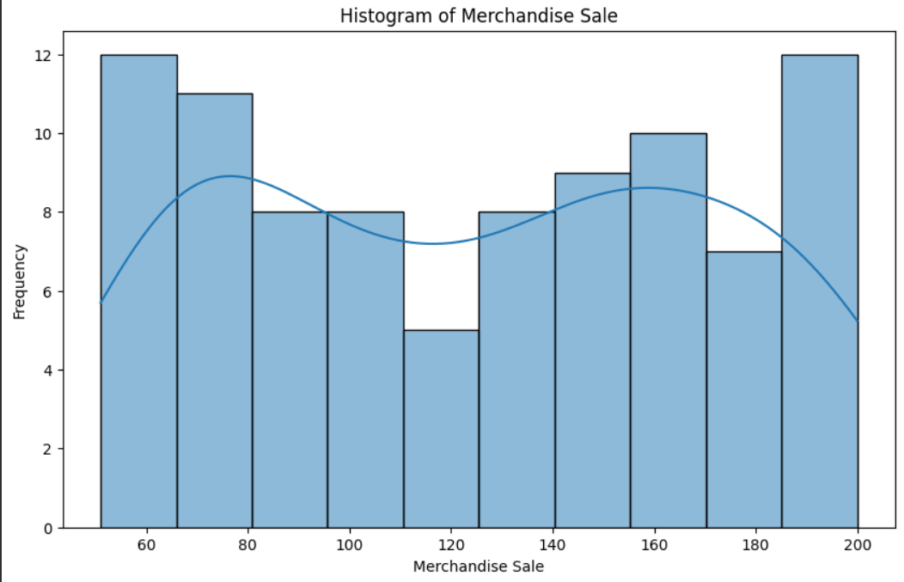
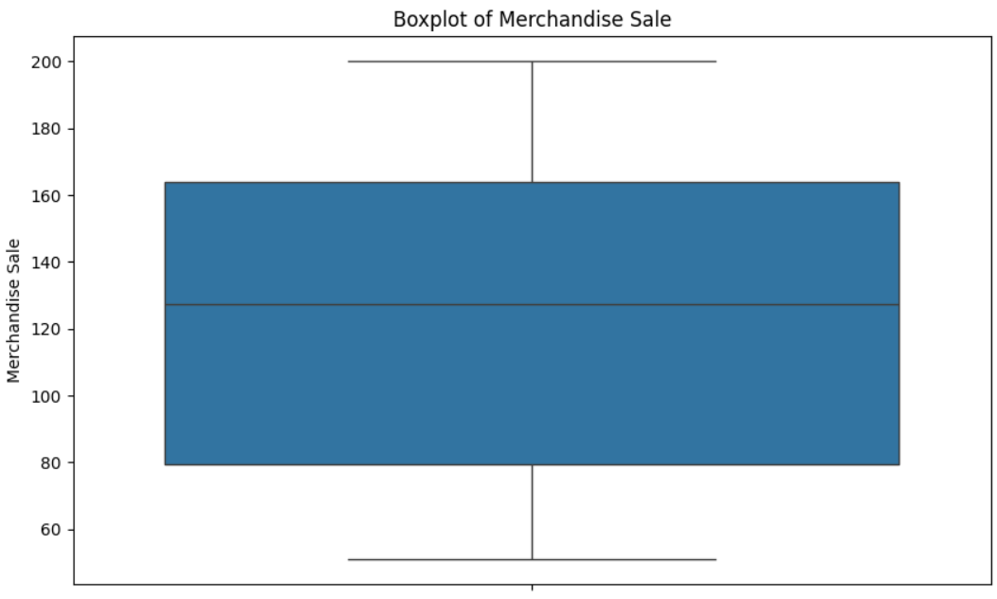
Data visualization

Slide 8
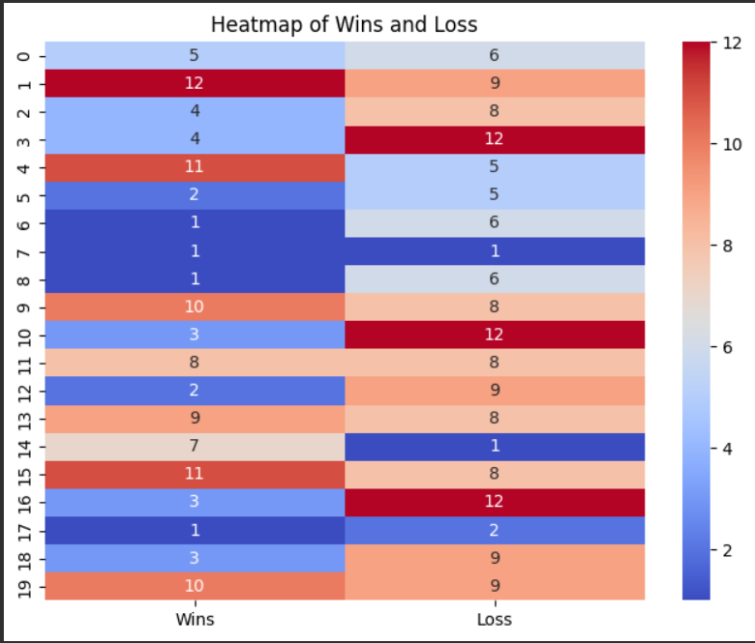
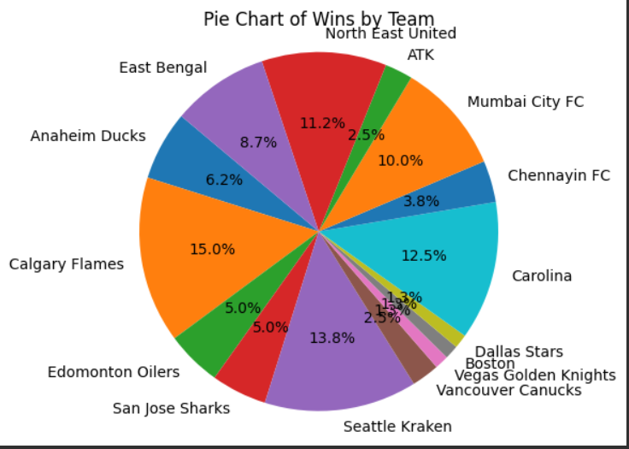

Slide 9

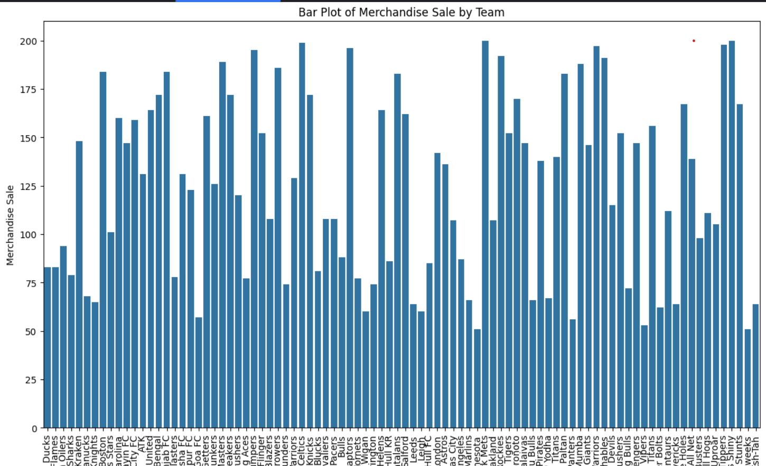

Slide 10
HyperParametre Selection
Merchanidise Sale + High Attendance , Loss , and Product of Merchandise Sale and High Attendance (To sort)

Slide 11
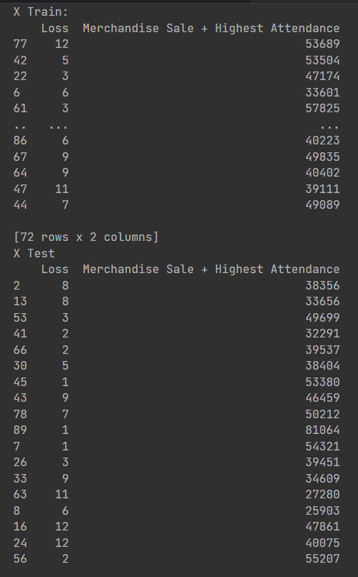
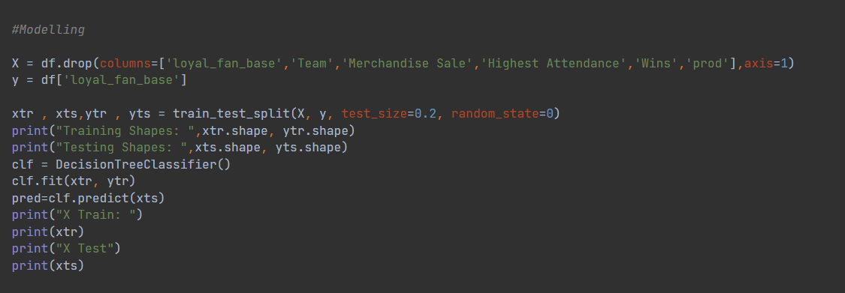
Machine learning model
Supervised Learning (DecisionTreeClassifier)

Slide 12
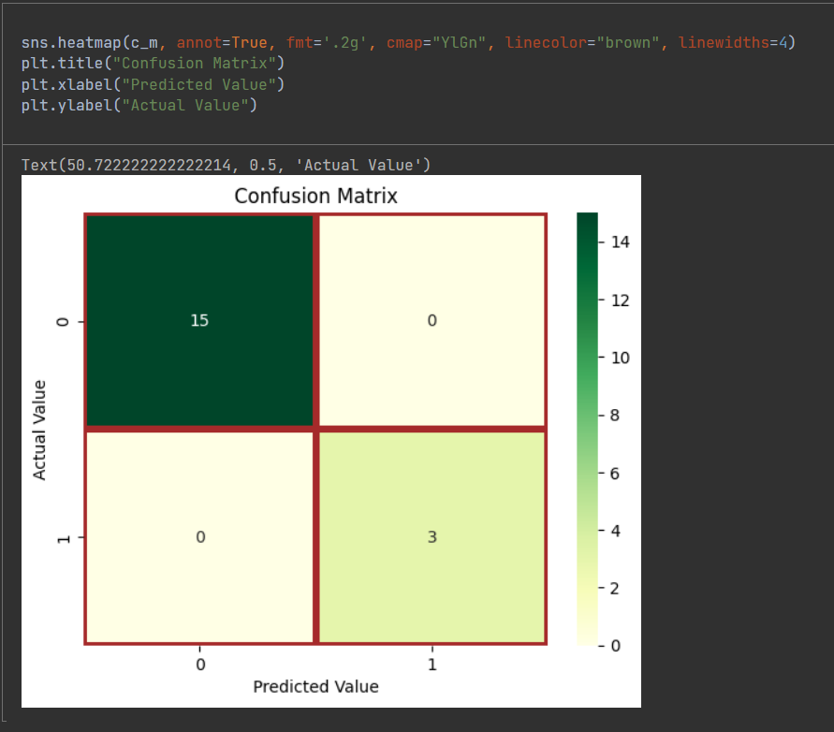
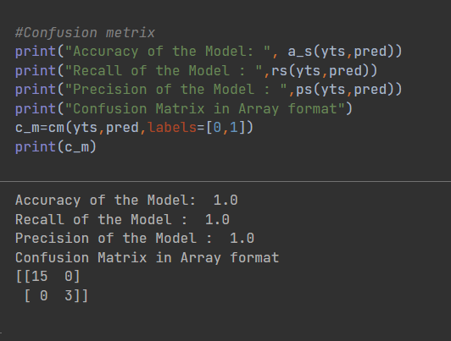
Performance metrics

Slide 13
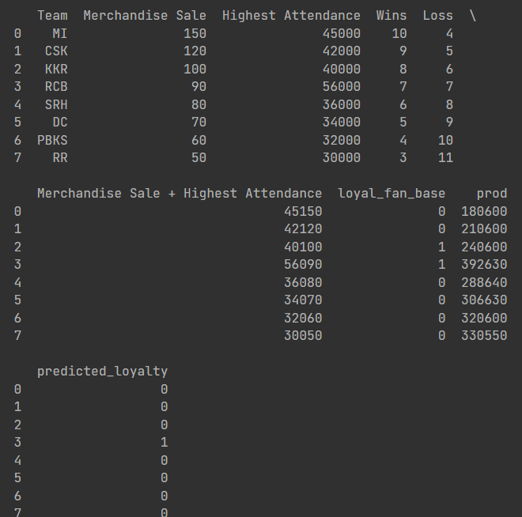
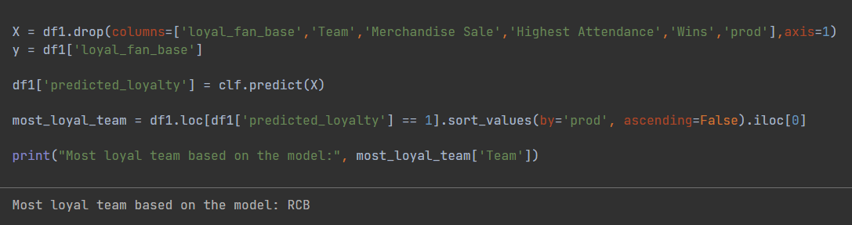
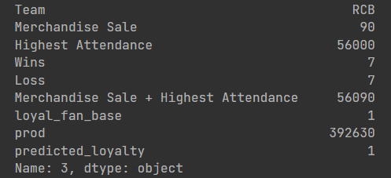
Predicted Output

